Slide 1
Nanopore Microbial Genomics Course
Aldert Zomer
Linda van der Graaf – van Bloois
Sam Nooij

Slide 2
Learning objectives
How to assemble genomes and check them
Determine MLST, detected resistance genes, plasmids for genomic epidemiology
How to annotate genomes and work with annotations
How to make phylogenetic trees of genome sequences
Understand the concept of the pan genome and the core genome and associate gene presence/absence with a phenotype (e.g. resistance) using contingency testing (“GWAS”)

Slide 3
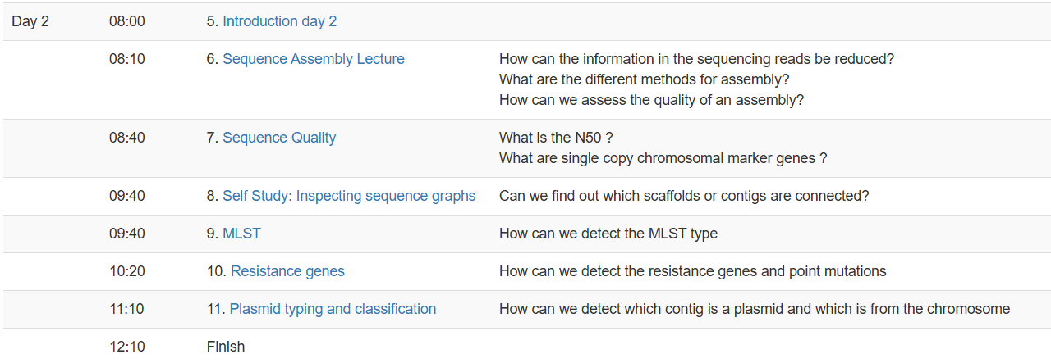
Part 1 – Genome assembly

Slide 4
Part 2 – Genomic Epidemiology

Slide 5
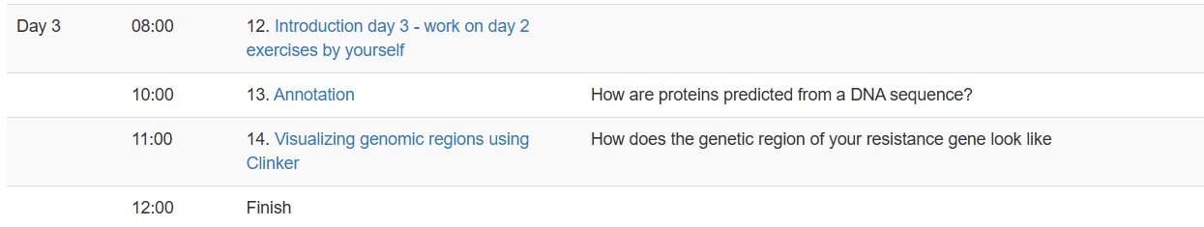
Part 3 Annotation

Slide 6
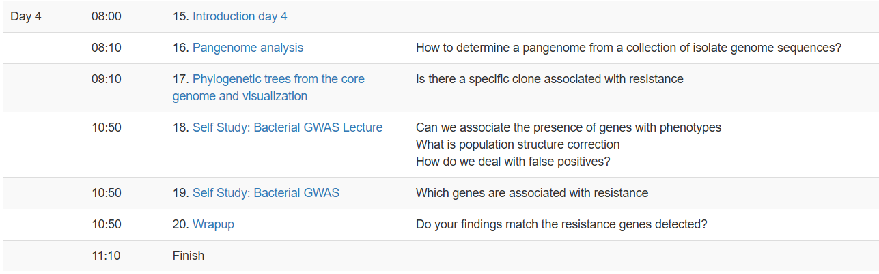
Part 4 Pan genome and trees

Slide 7

How to speak the language of the commandline
Aldert Zomer
Soe Yu Naing
Rahadian Pratama
Linda van der Graaf-van Bloois
©pixabay

Slide 8
Linux file system (basic)
Directories
/
root
Linux files are stored in a single rooted, hierarchical file system
Data files are stored in directories (folders)
Directories may be nested as deep as needed
etc
home
usr
passwd
inittab
User home directories
aldert
rahadian
soeyu
a
b
Data files

Slide 9
Naming files in Linux
Files are named by
naming each containing directory
starting at the root
This is known as the pathname
/
etc
home
usr
passwd
inittab
/etc/passwd
Absolute path:
/home/aldert/a
Relative path:
~/a
aldert
rahadian
soeyu
a
b
/home/aldert/b

Slide 10
Some special file names
Some file names are special:
/ The root directory (not to be confused with the root user)
. The current directory
.. The parent (previous) directory
~ My home directory
Examples:
./a same as a
../jane/x go up one level then look in directory jane for x

Slide 11

Linux terminal
Terminal or often calles shell / command prompt, is where the user able to interact directly with the OS

Slide 12
Commands in terminal
Some basic commands in linux terminal often used:
cd - to change directory
ls - list the files in the directory
mkdir - create directory
rm - remove file(s)
cp - copy a file from one location to other
mv - move file to other location. Can rename file

Slide 13
Course outline
Working in groups when possible – help eachother
Web browser needed (Chrome, Edge, Firefox, etc)
https://klif.uu.nl:8080/
Login using username and password given in the chat

Slide 14
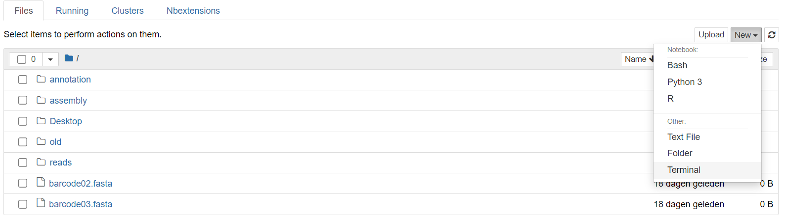
Commandline/shell/terminal/CLI

Slide 15
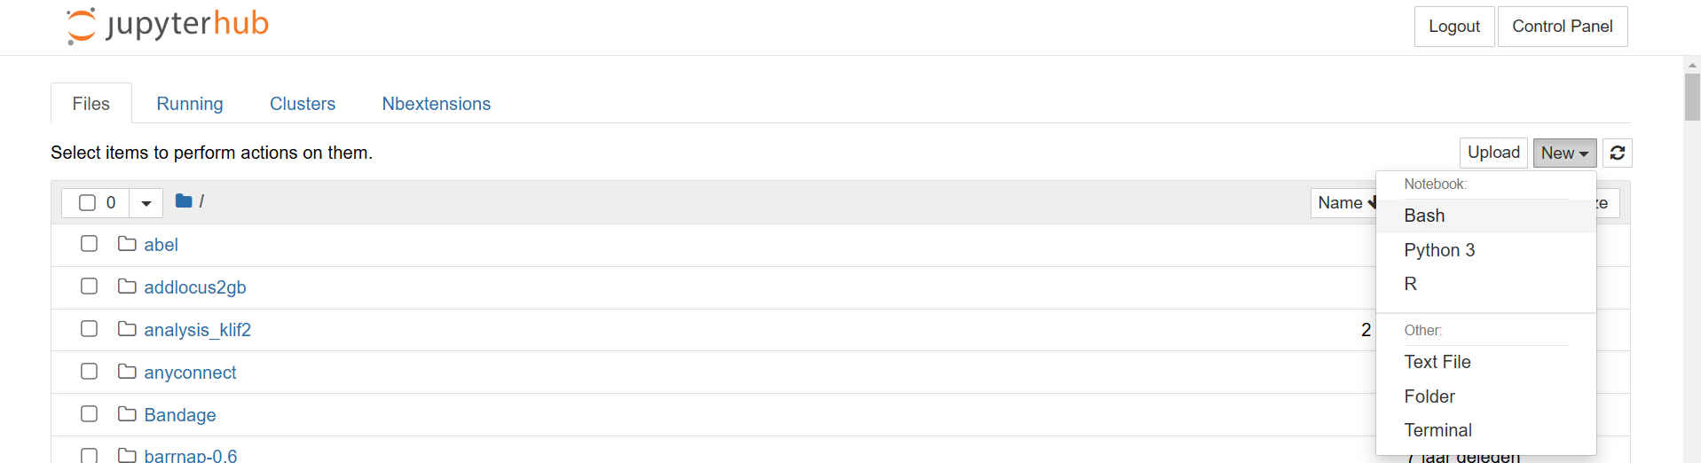
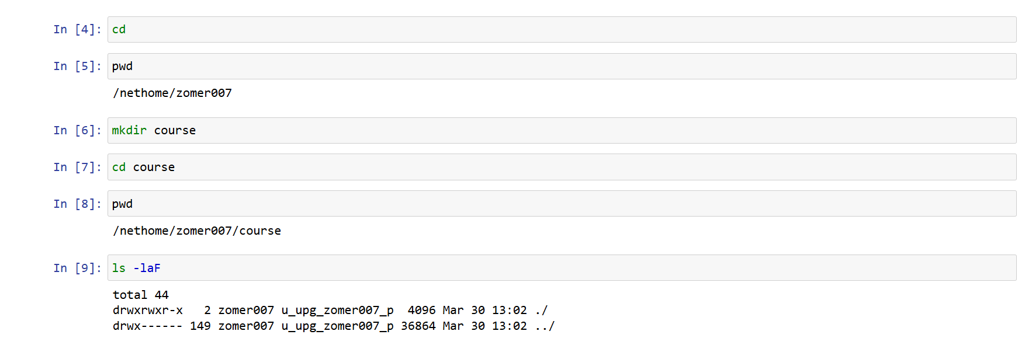
Commandline/shell/terminal/CLI via a notebook

Slide 16
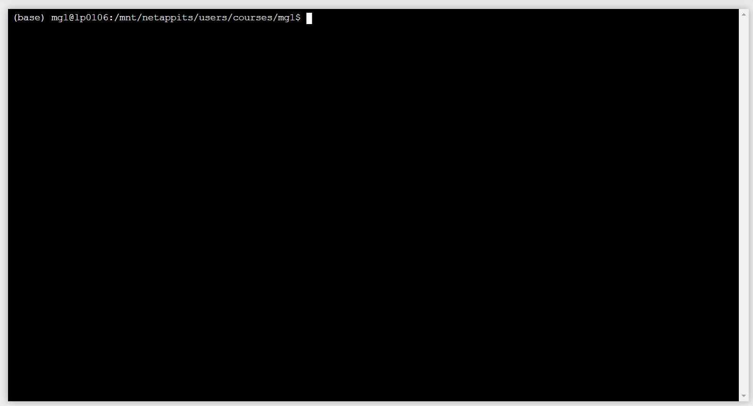
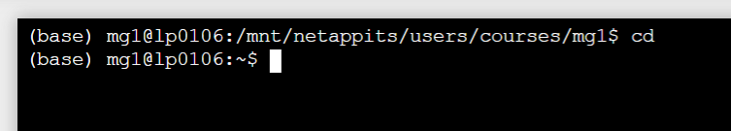
Your home (~) folder on the server
What do I do with this? Help!
Your username
Your active environment (conda)
~ is also your home

Slide 17
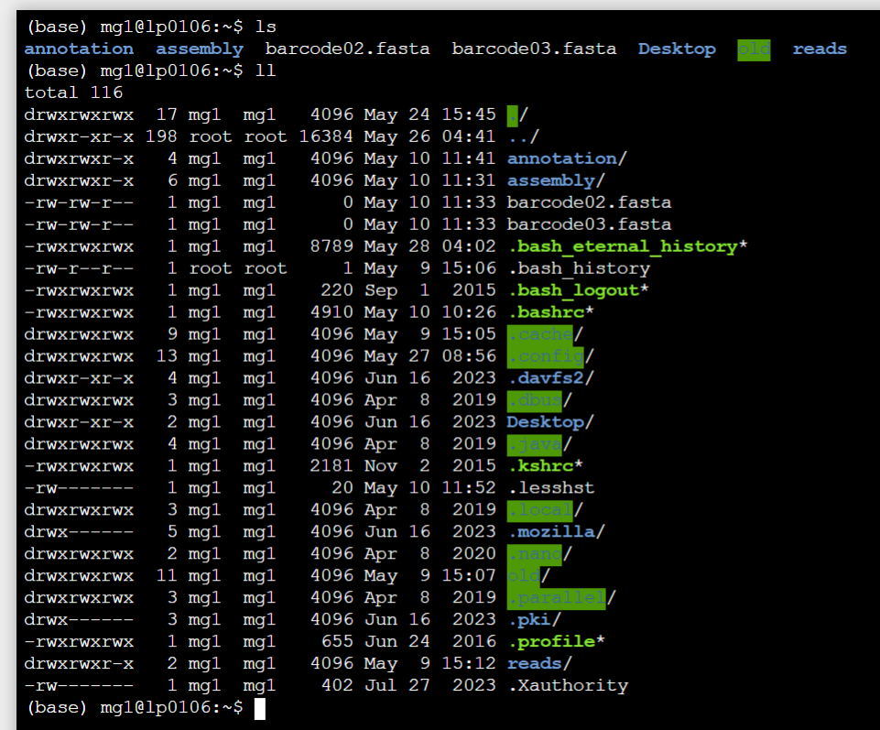
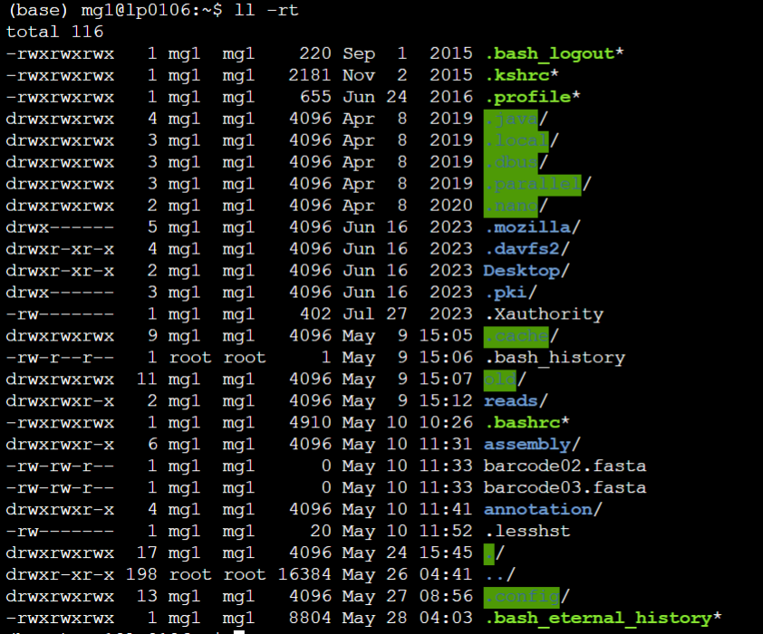
Listing files
ls #list filenames. Do not list hidden files (files starting with .)
ls -laF #list your files with details
ll # shortcut to list your files with details
ll -rt # list your files sorted with oldest at top, newest at bottom

Slide 18
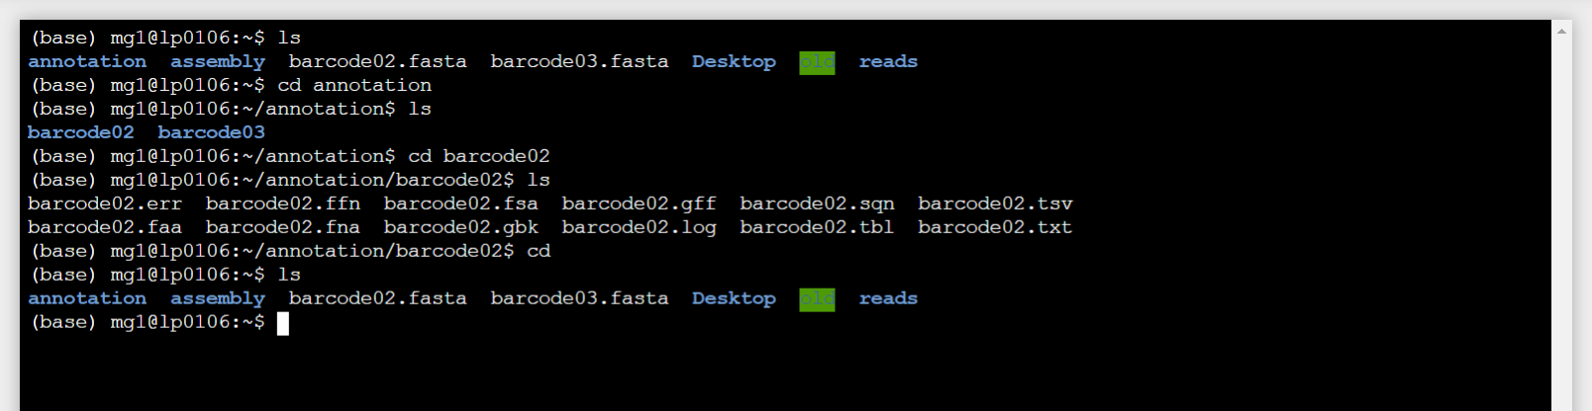
Go to a different folder
cd # go back to your home
cd folder # go into the folder
cd .. # go one folder up

Slide 19
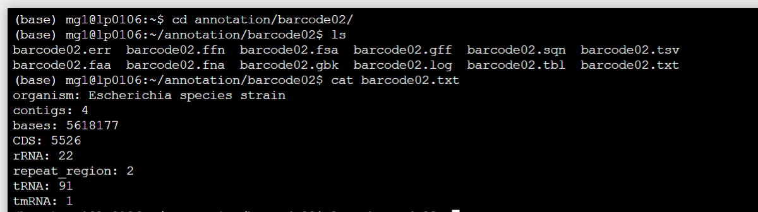
Showing a file on the screen
cat file #display the whole file on the screen at once
less file #display the file per page
less -S file #display the file per page with scroll left/right

Slide 20
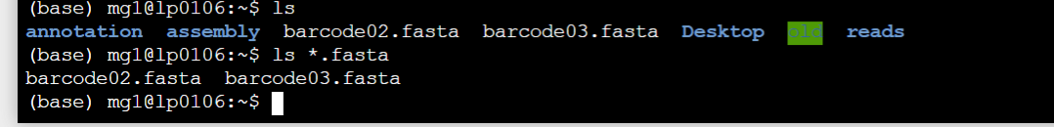
“wildcards”
ls *.fasta # lists all files matching .fasta . The * is a wildcard

Slide 21
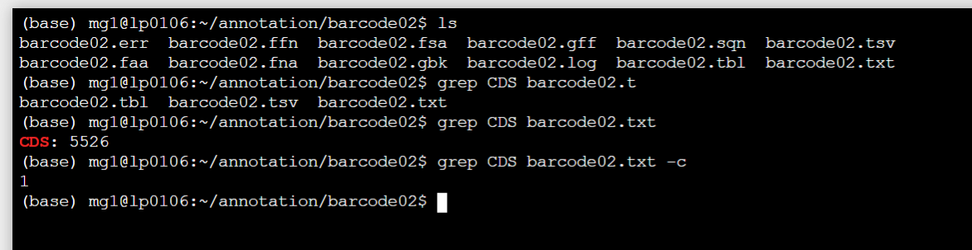
Finding a word in a file
grep word file #find the word “word” in file
grep word file -c #find the word “word” in file and count

Slide 22
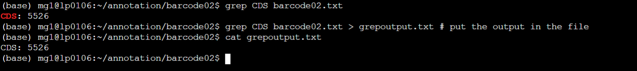
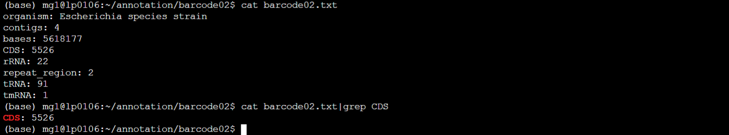
Redirecting output to file or to another program
This is a crucial part. The commandline allows us to send screen output to a file with ‘>’ or to another program with ‘|’

Slide 23






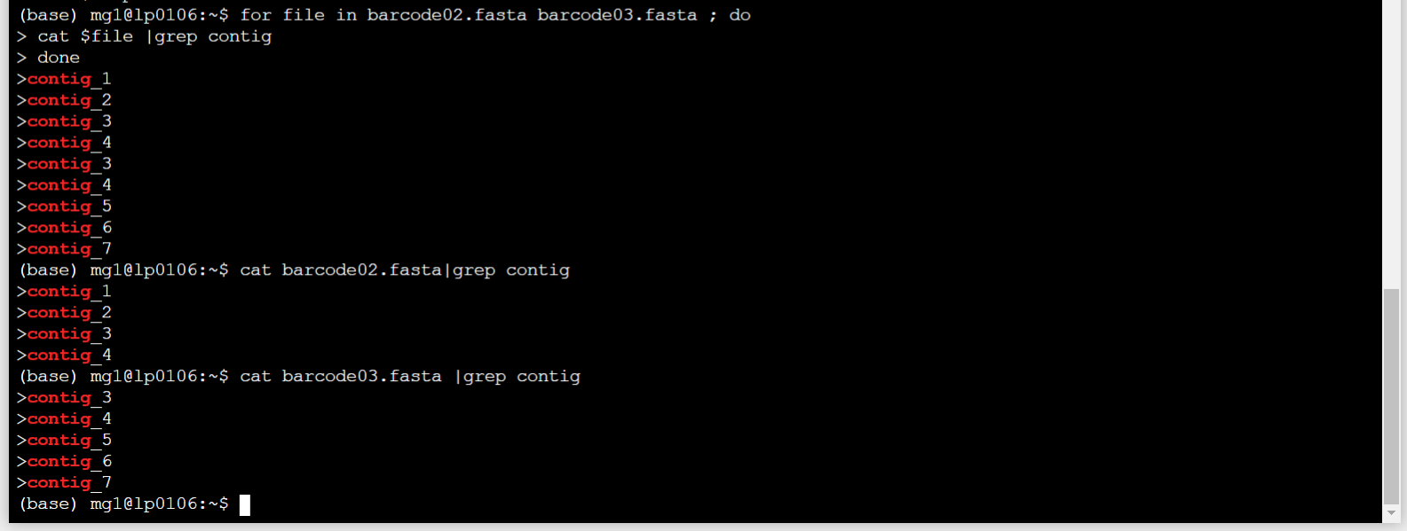
Loops – how to process many files
for name in sample1 sample2 sample2 ; do
cat $name
done

Slide 24
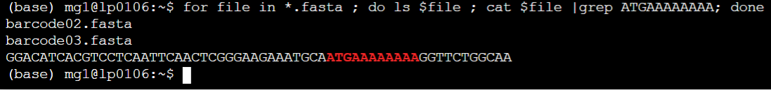
Very fancy loops
“;” takes the place of pressing enter
Everything that looks like .fasta
List the filename
and also grep for the pattern ATGAAAAAAA

Slide 25
Stopping a command
Sometimes a command is running but you realized you made an error.
Press “Ctrl-C” to stop the command. In a loop several presses are needed to get out of the loop(s)
If this fails, there is press Ctrl-Break . Usually not available on laptop keyboards. Unlikely that this needs to be used.

Slide 26
Other commands.
tr “a” “b” # replace a letter in an output (a with b)
sed ‘s/contig/c/’ # replace words in an output (contig with c)
cut -f 1 # select a column from the data (here : 1)
echo “word” # print a word or words on a screen
head -n 10 # print the first 10 lines
tail -f 10 # print the last 10 lines
conda # activate or deactivate a different software environment
https://www.codecademy.com/learn/learn-the-command-line/modules/learn-the-command-line-navigation/cheatsheet

Slide 27
Questions, help
Raise the hand in the Zoom session
Type the question in the chat
We will answer the question and also follow up in the chat for others if they missed the explanation

